Slide 1
Triage, Response, and Investigations

Slide 2
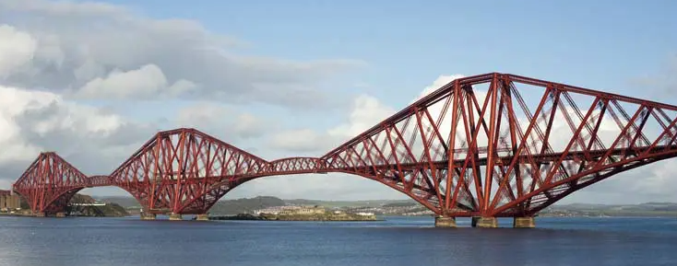
Bridge Over Incident Waters
SOC
Triage alerts, perform initial troubleshooting, analysis and escalate to IR.
IR
Respond to escalations, investigate, research, contain, and repel attacks.
Forensics
Perform deep analysis of an incident, creating a timeline of events and – where appropriate, suggest possible conclusions.
Forensics
IR
SOC
T

Slide 3
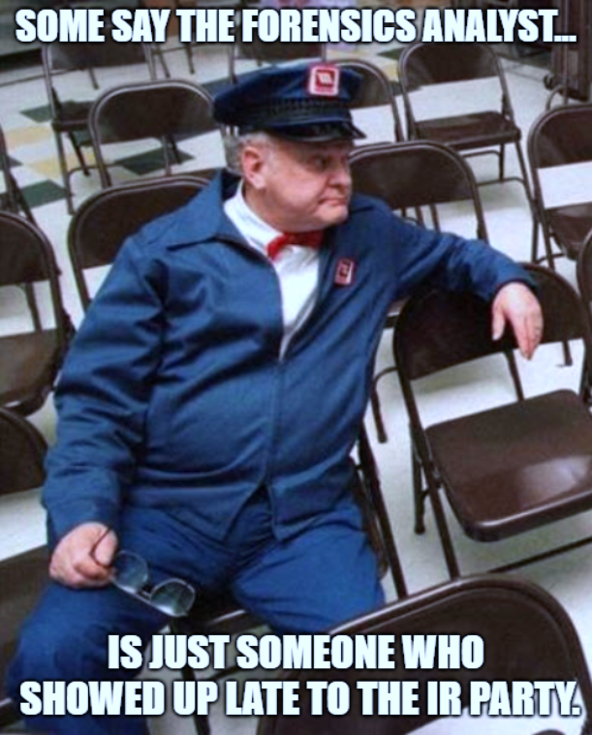
Scope and Purpose for SOC, IR, and Forensics
SOC and IR
Detect (Eng.)
Triage (SOC)
Analyze (SOC to IR)
Respond / Contain (IR)
Remediate (IR + Eng.)
Forensics
Catalogue
Collect
Analyze
Preserve
Report
J

Slide 4

SOC
Security Operations Center (SOC)
Work notables in a SIEM and triage the items identified, to determine what items constitute an incident, requiring escalation
J

Slide 5
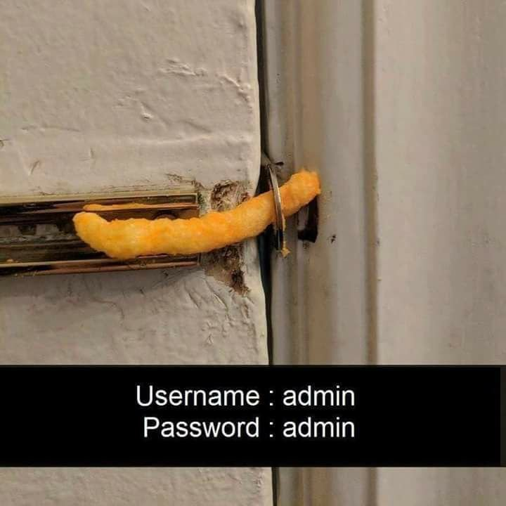
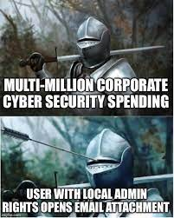
A day in the life of a SOC Analyst
J

